Slide 1
بِسْمِ اللهِ الرَّحْمٰنِ الرَّحِيْمِ

Slide 2

“MCQ-Based Test System for Exam Preparation Using Python and Django”

Slide 3

Supervisor “Muhammad Kaleem Ullah”
Submitted By
Emaan Murtaza
(Bc230209941)
F24PROJECT47C82

Slide 4

Introduction to MCQ-Based Test System for Exam Preparation Using Python and Django Project
The MCQ-Based Test System is an innovative educational platform created to transform test design and preparation.
This system creates a dynamic and encouraging learning environment by giving teachers the ability to create and administer personalized tests using an extensive question bank or AI-powered multiple-choice question generator, and by allowing students to take personalized tests, get immediate feedback, and track their progress.
The platform was developed with flexibility, security, and scalability in mind. It meets a wide range of user requirements and, in the end, improves the teaching-learning process.
The scope includes the following:
Supporting Multiple Subjects
User-Friendly Interface for Teachers
Student Features
NLP Integration for MCQ Generation
Platform Security and Responsiveness
Comprehensive Solution for Exam Preparation

Slide 5
Functional Requirements
User Registration and Profile Management (Teacher and Student):
•Permit students and instructors to sign up and make profiles.
•Give educators access to tools for creating tests and managing their profiles.
•Give students the ability to monitor performance metrics and take assessments.
2. Question Bank Management (Teacher):
•Give educators the ability to add, modify, or remove questions from a single question bank.
•Encourage the grouping of questions according to their type, difficulty, subject, and theme.
3. Test Creation and Customization (Teacher):
•Give teachers the option to use the automatic MCQ generating feature or choose questions from the question bank to produce tests.
•Allow test customization by adjusting the time restrictions, difficulty levels, and question count.
4. Test Execution and Real-Time Evaluation (Student):
•Give students the opportunity to take tests and receive immediate feedback on their responses.
•Automatically evaluate answers and display appropriate options and justifications.

Slide 6
Functional Requirements
5. Performance Tracking and Analytics (Student and Teacher):
•Give students access to performance analytics and test results so they may monitor their development.
•Give teachers information about trends in both individual and group performance
6. Automatic MCQ Generation from Text (Teacher):
•Use NLP algorithms to automatically create multiple-choice questions from text input.
•Give teachers the ability to examine and modify the questions that are created.
7. Data Analysis and Preprocessing:
•Examine the MCQ dataset to make sure there is a broad range of subjects and skill levels.
•Sort questions according to themes, level of difficulty, and question type as part of the preprocessing step.
8. User Model Development:
•To control access and functionality, assign distinct user roles to instructors and students.
•To give tailored feedback and suggestions, keep track of students' progress, question tries, and scores.

Slide 7
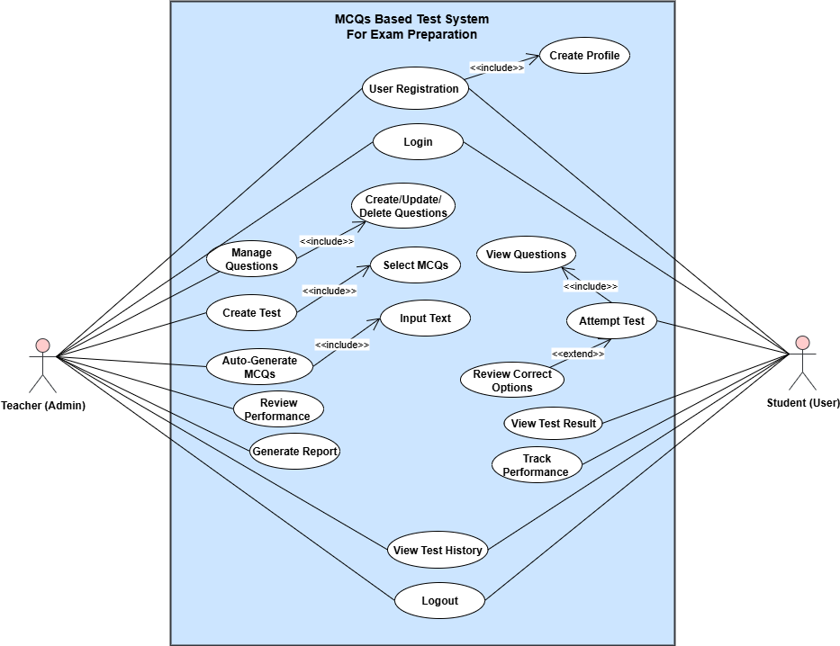
Use
Case
Diagram

Slide 8
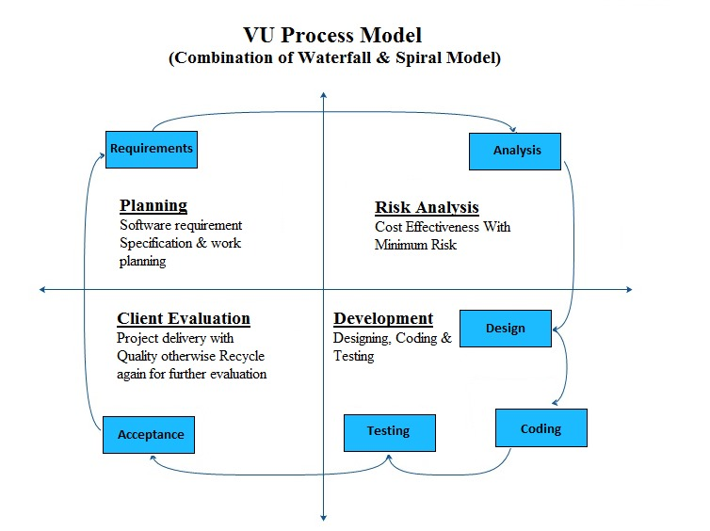
Adopted Methodology
VU
Process
Model

Slide 9
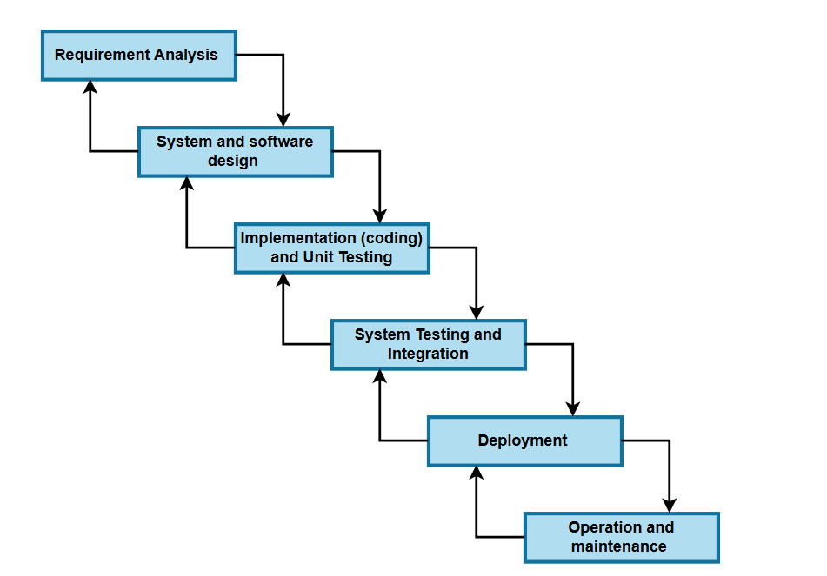
VU Process Model
Waterfall
Model

Slide 10
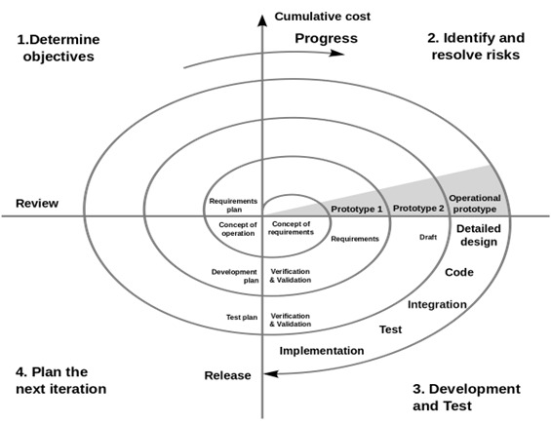
VU Process Model
Spiral
Model

Slide 11
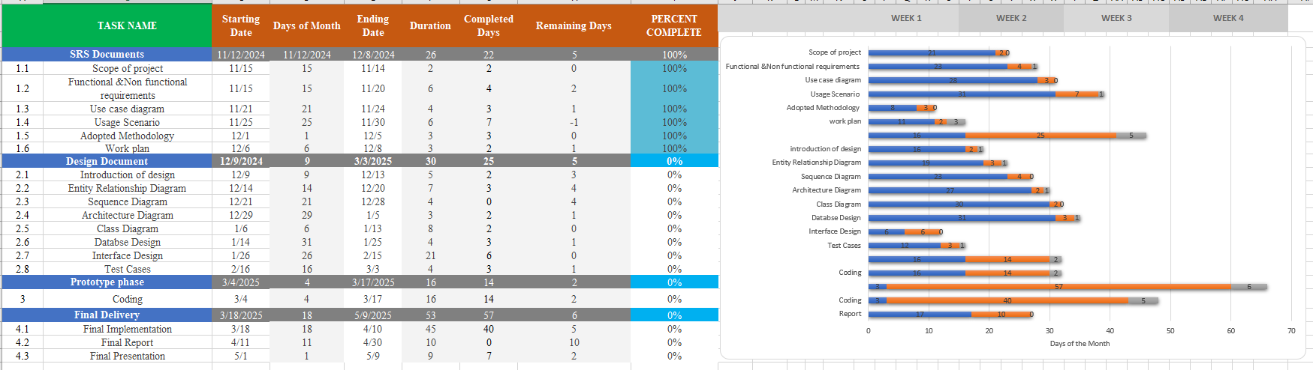
Gantt Chart

Slide 12
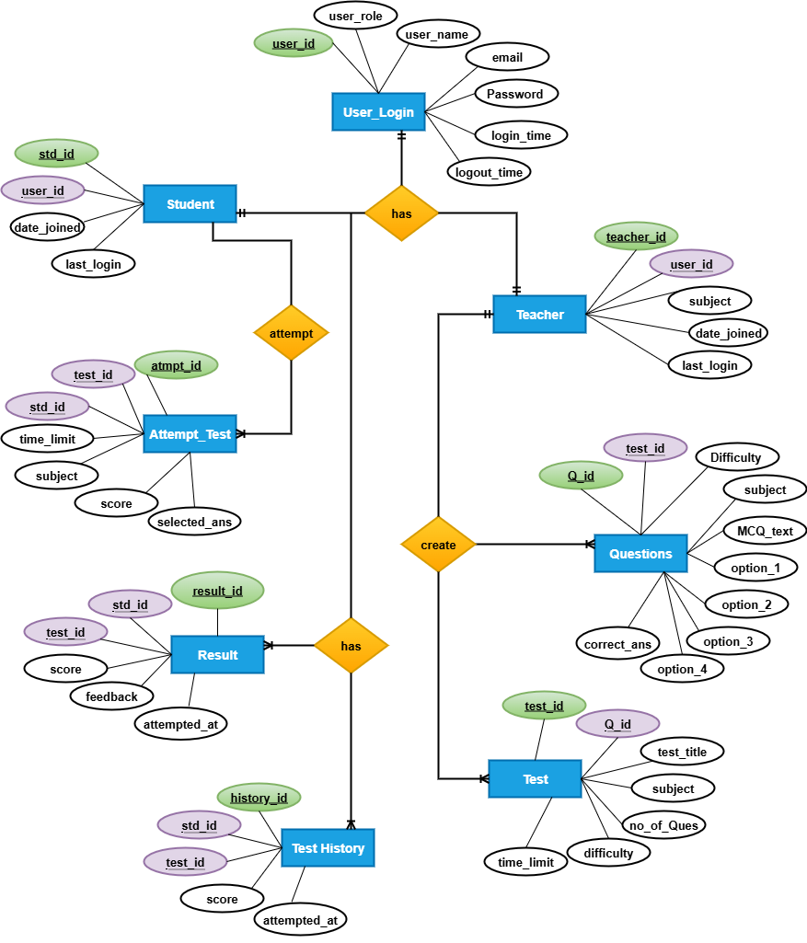
Entity
Relationship
(ER)
Diagram

Slide 13
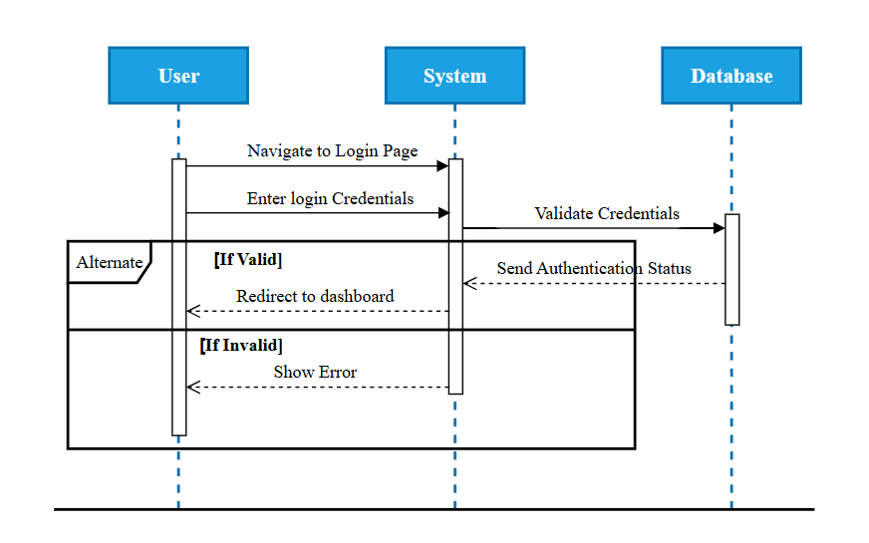
Sequence Diagrams
User
Authentication

Slide 14
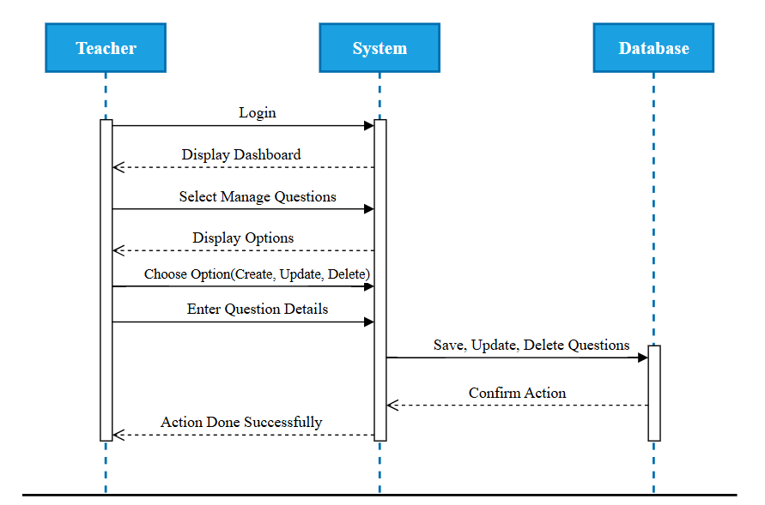
Sequence Diagrams
Manage
Mcqs
(Teacher)

Slide 15
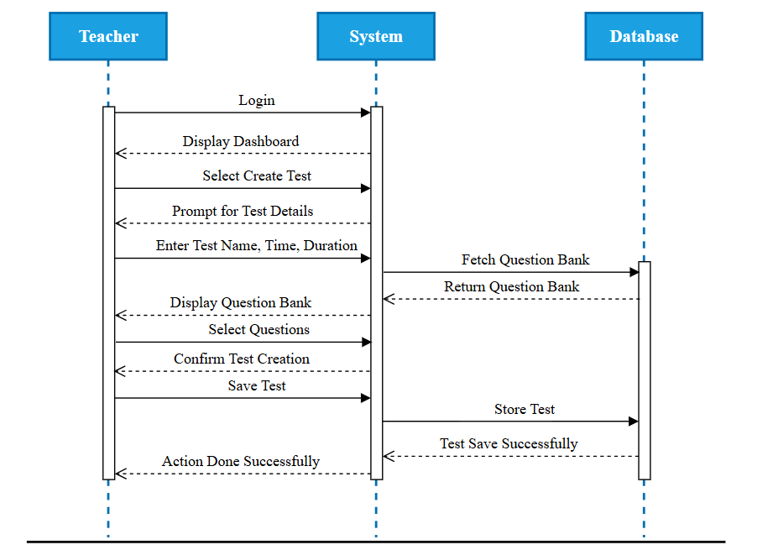
Sequence Diagrams
Test
Creation
(Teacher)

Slide 16
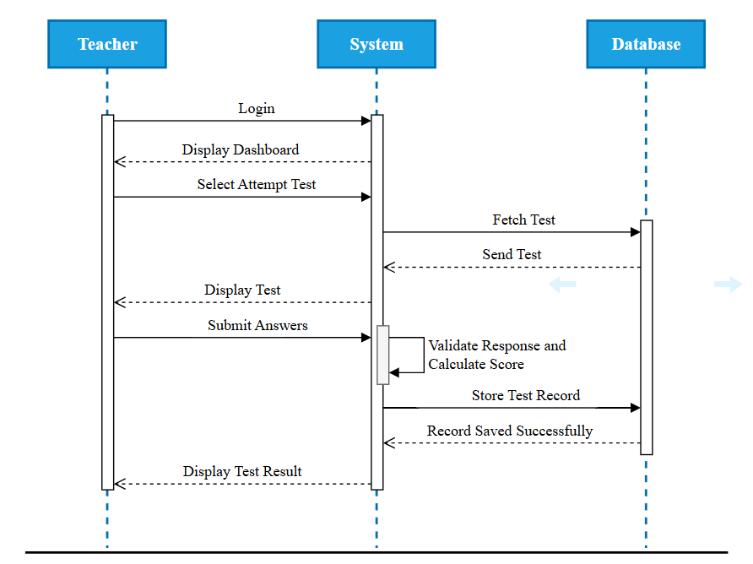
Sequence Diagrams
Attempt
Test
(Student)

Slide 17
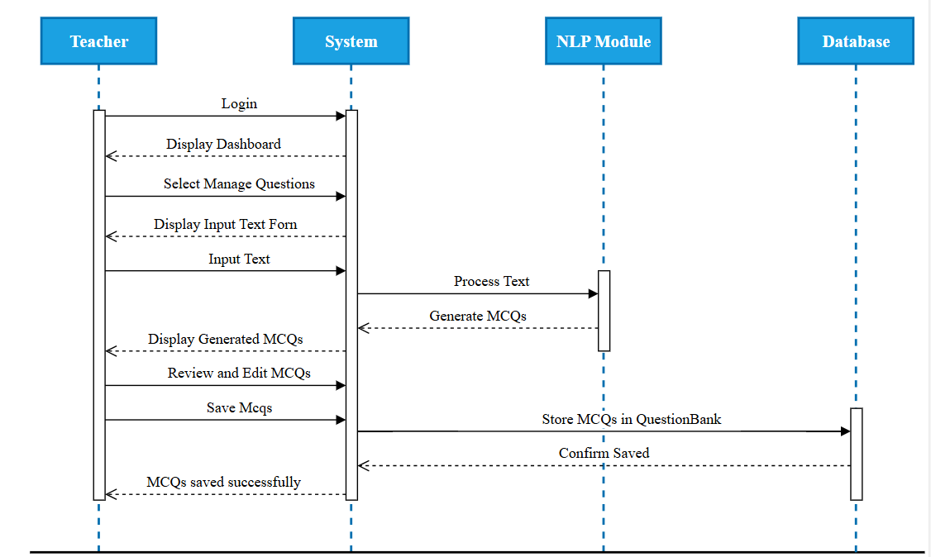
Sequence Diagrams
Automatic
MCQs
Genetation
(NLP)

Slide 18
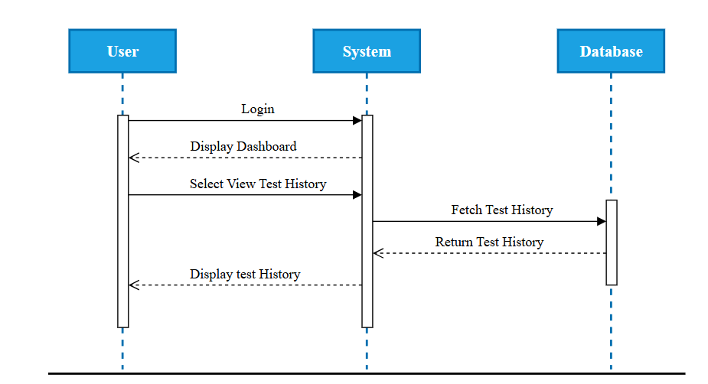
Sequence Diagrams
View
Test
History

Slide 19
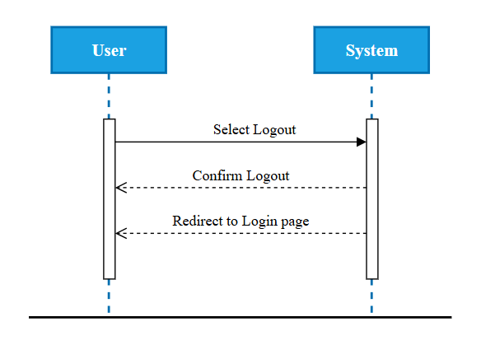
Sequence Diagrams
Logout

Slide 20
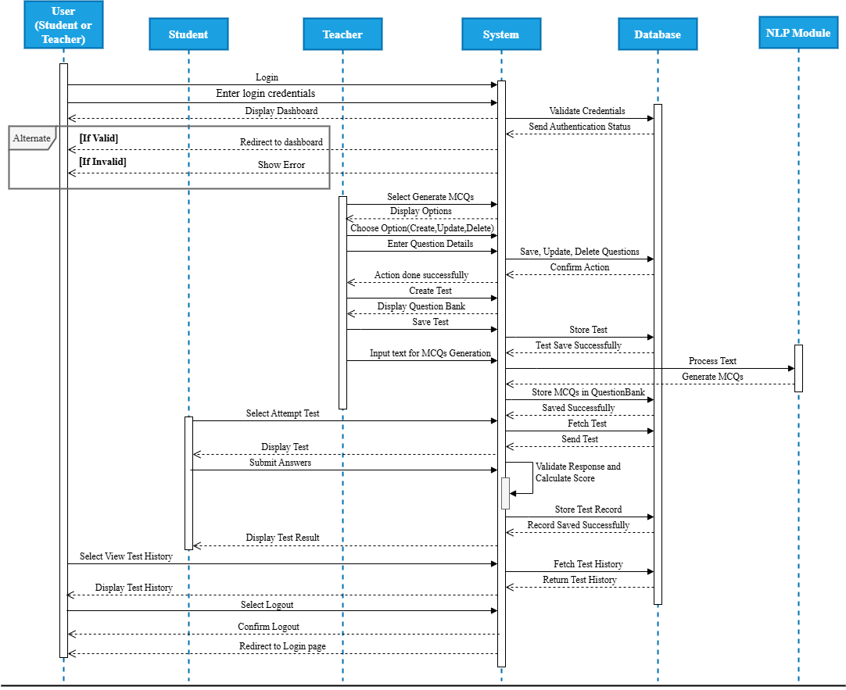
Sequence Diagrams
Overall
System
Sequence
Diagram

Slide 21
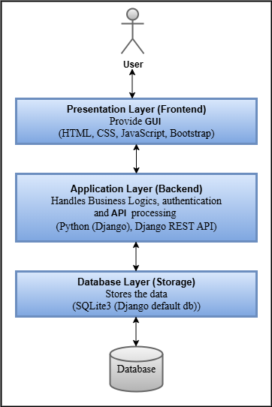
Architecture Design Diagrams
The high-level structure of the MCQ-Based Test System is described in the Architecture Design Diagram.

Slide 22
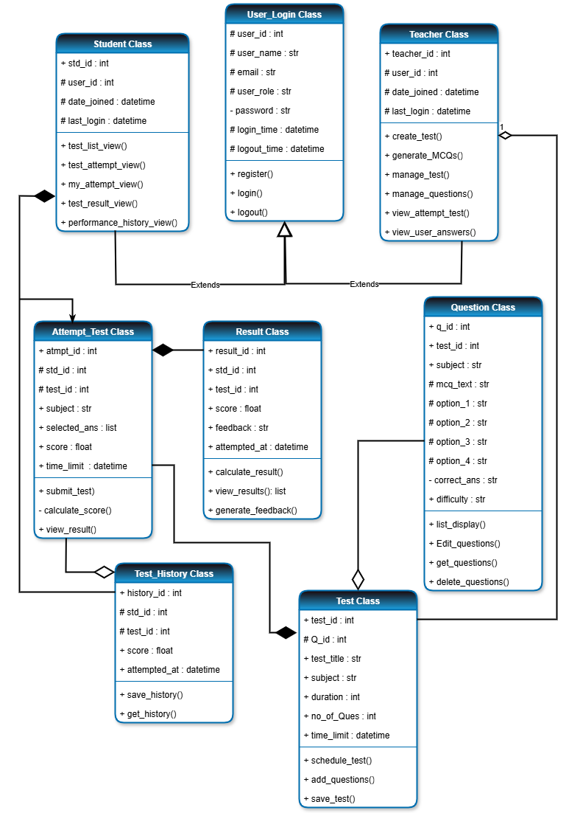
Class Diagram
The Class Diagram represents the object-oriented structure of the MCQ-Based Test System by defining its key classes, attributes, and relationships.

Slide 23
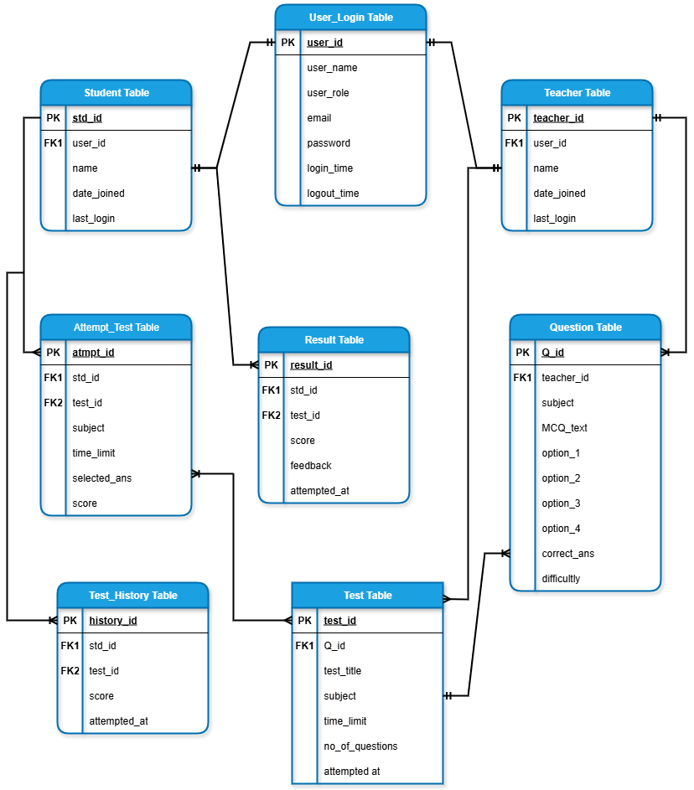
Database Diagram
The Database Design of the MCQ-Based Test System defines structured data storage, ensuring efficient retrieval and management of users, questions, tests, and results.

Slide 24
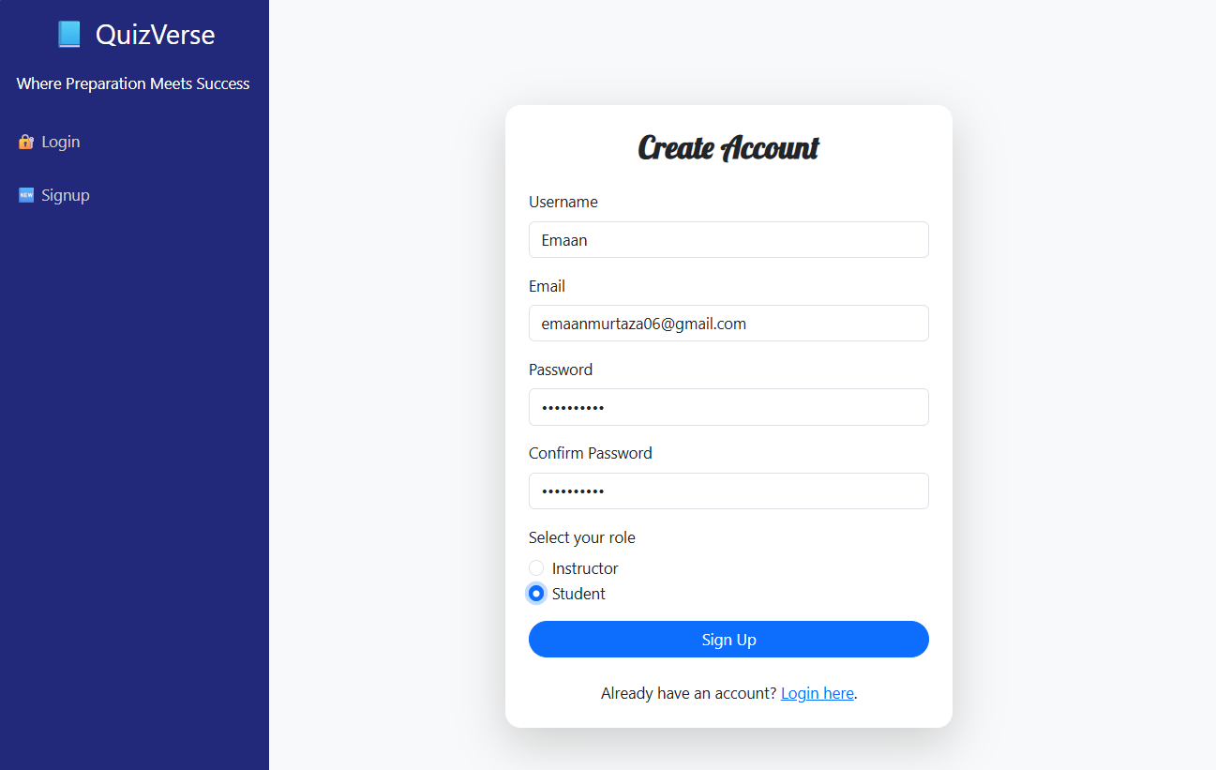
GUI Interface
Registration

Slide 25
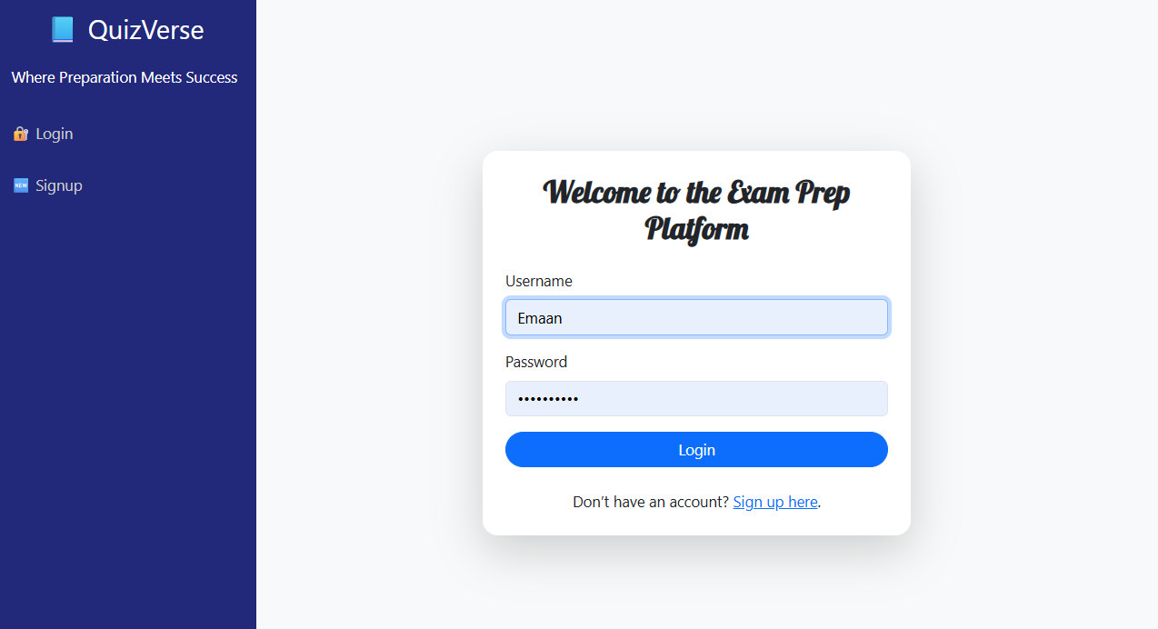
GUI Interface
Login
Interface

Slide 26
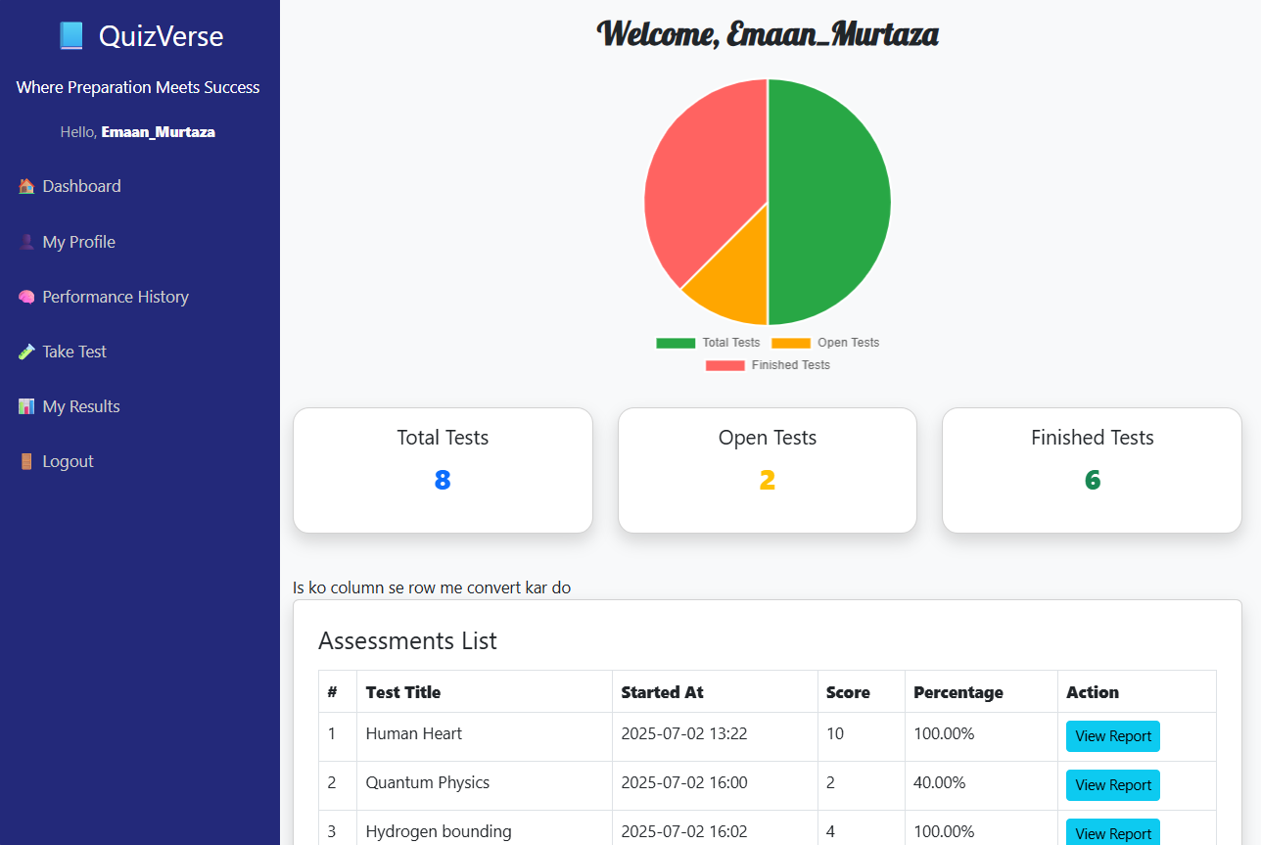
GUI Interface
Student
Dashboard

Slide 27
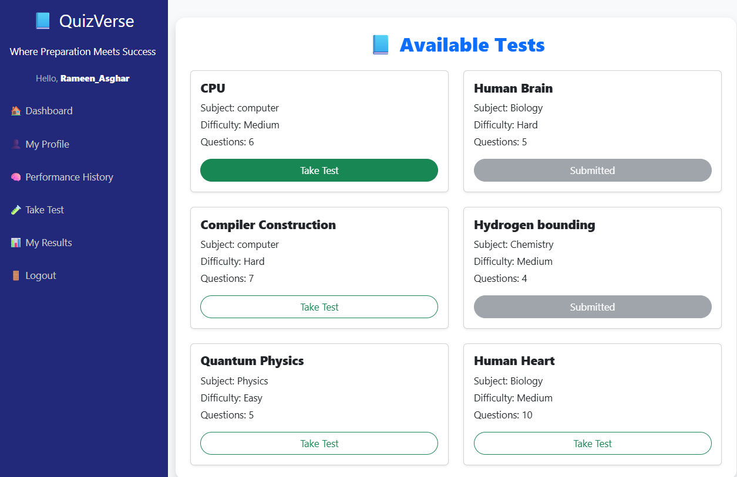
GUI Interface
Student
Starting
Test
Interface

Slide 28
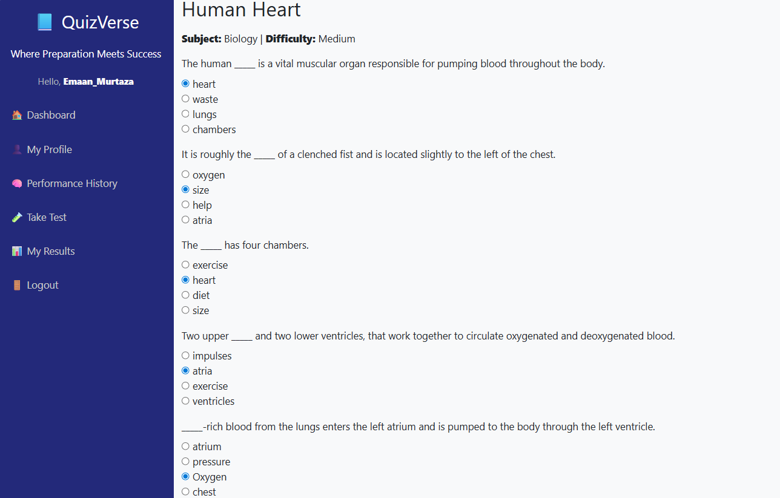
GUI Interface
Student
Attempting
Test
Interface

Slide 29
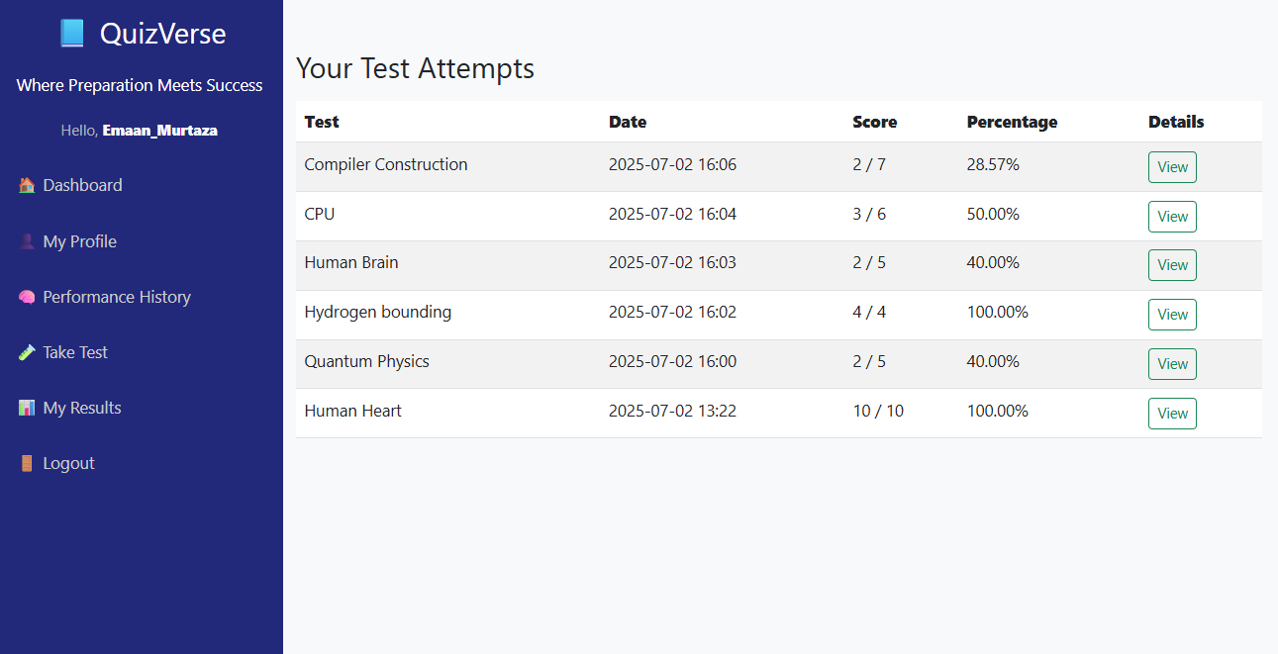
GUI Interface
Result
Interface

Slide 30
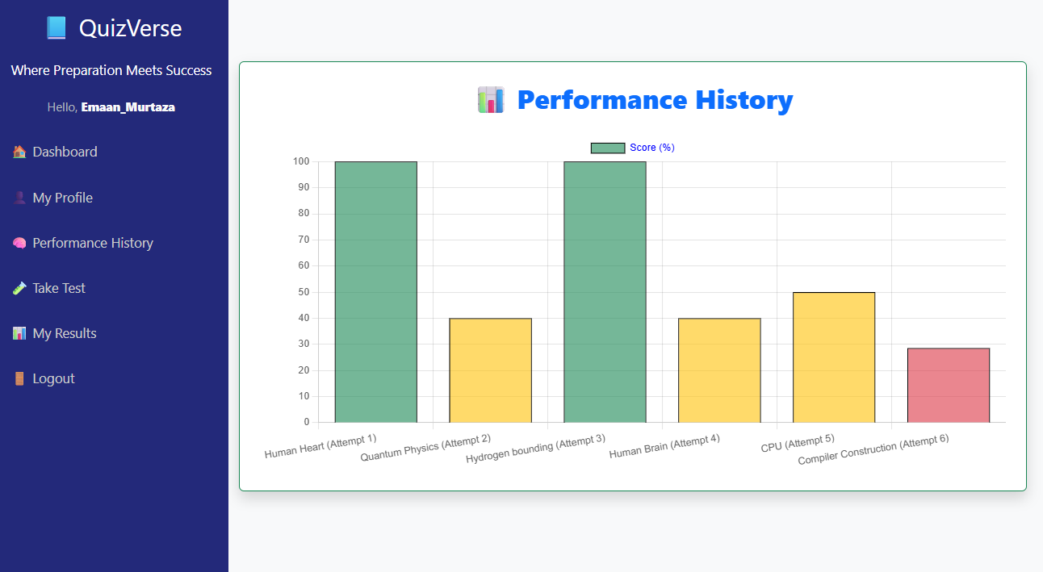
GUI Interface
Performance
History
Interface for Student Side

Slide 31
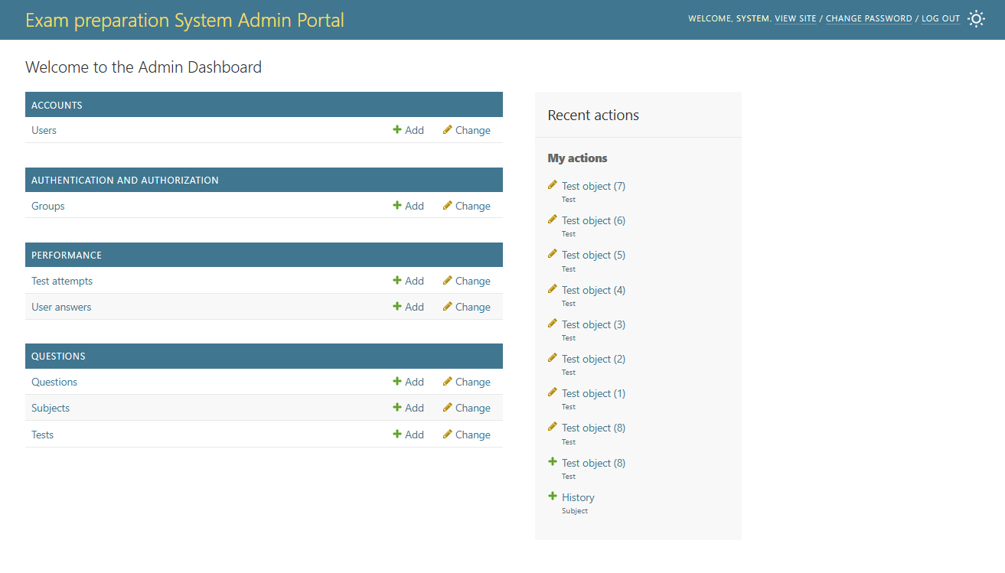
GUI Interface
Admin
Dashboard

Slide 32
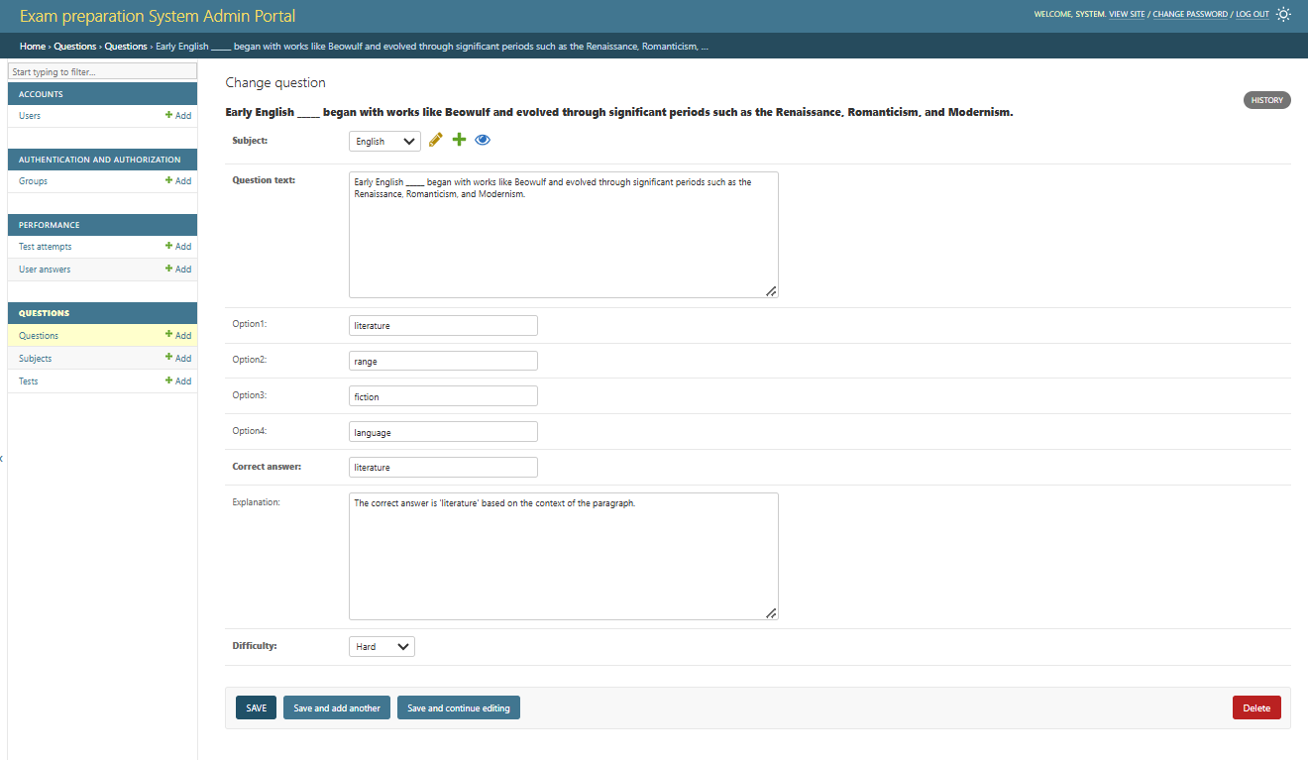
GUI Interface
Teacher
Managing MCQ
Interface

Slide 33
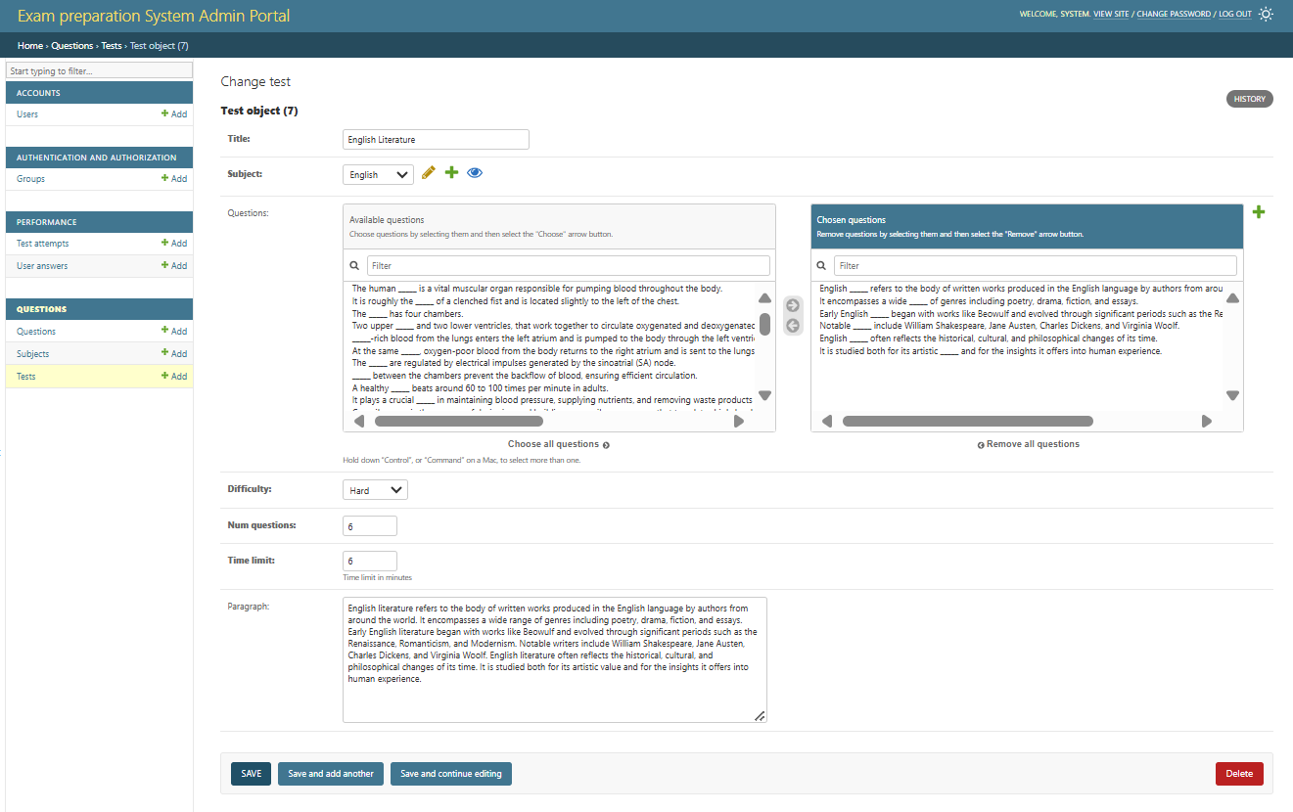
GUI Interface
Teacher
Creating Test
Interface

Slide 34
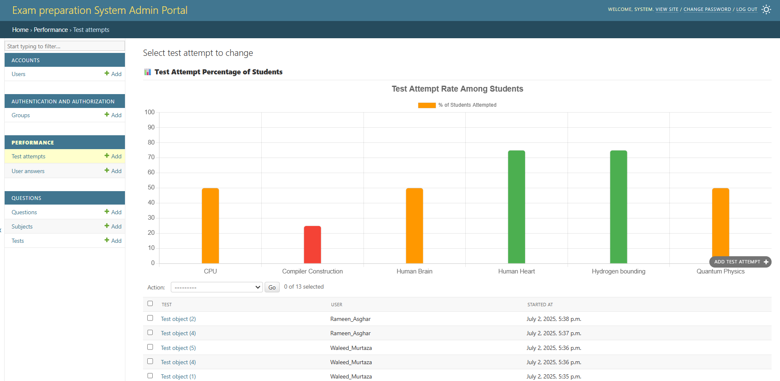
GUI Interface
Performance History
Interface
for Admin
Side

Slide 35
Development Phase
Tools
And
Technologies
Languages:
Python (Django), HTML, CSS, JavaScript, Bootstrap
Database Tool:
SQLite 3 (default built-in database engine provided by Django)
IDE:
Visual Studio (VS) Code
Other Tools:
Microsoft Office (Word, Visio, PowerPoint, MS Project)

Slide 36
That concludes my presentation Thank you, Sir

